Slide 1
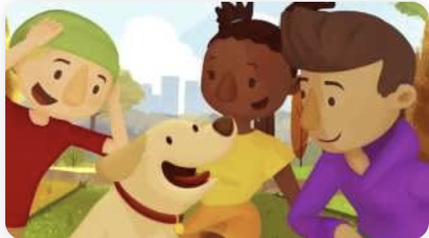
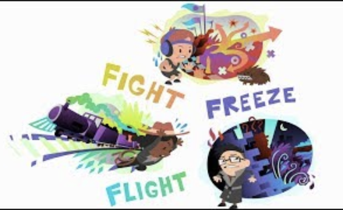
Bullying and Emotional Health
Be a good friend!
Be Respectful!
Wellbeing

