Slide 1
Summer Steps for Juniors

Slide 2
Standardized Testing
Determine what testing you need for your colleges- take the SAT and/or ACT.
Some colleges do not require testing- see www.FairTest.org for a list and make sure you check your school’s test optional policy with Covid19
Remember that standardized tests can count for your exit assessment. Options include: PARCC, PSAT, SAT, ACT, ASVAB or Accuplacer
Check out options for summer SAT prep and college essay writing here

Slide 3
How to register for testing
ACT: Registration deadlines fall approximately five weeks before each ACT test date. You can register online on the ACT website.
SAT: SAT registration deadlines fall approximately five weeks before each test date. Register online on the College Board website. The College Board may require SAT registration by mail under special circumstances.
If you are on free/reduced lunch, talk to your counselor about a fee waiver

Slide 4
Using Naviance
Use Naviance and College Board to do career and personality assessments. These websites also allow you to research careers, majors and colleges you may have interest in as well.
Both sites provide advanced searches that allow you to find a specific school that fits your wishes (e.g. school type, location, athletics, etc.)

Slide 5
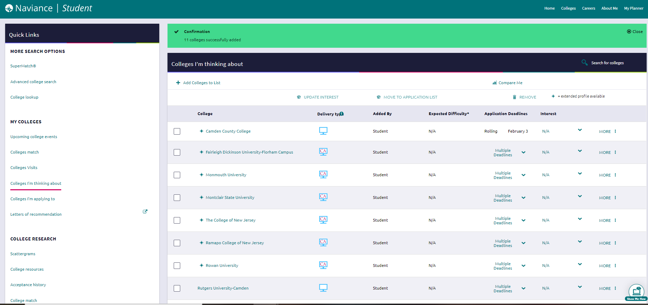
Naviance
Once you have discovered some colleges you’re interested in, update your “Colleges I’m Thinking About,” list so you and your counselor can discuss these schools in September
You can also update your resume (“About me”) in Naviance as well

Slide 6
Campus Visits
Although it is better to visit schools when they are in session, summer is a great time to start visiting college campuses! Check college’s websites for visit info.
New Jersey School Counselor Association has a list of college open houses on their website
Check out some options for virtual college tours here
Meet with college reps when they visit West- see list on Naviance. Sign up on Naviance or see counselor for more information.

Slide 7
Brag Sheet & College Essay
Fill out your brag sheet and have your parent/guardian fill out theirs so that your counselor can begin to write your recommendation letter. You can also begin to submit requests for recommendation letters from other teachers as well.
Start looking at your college essay topics and planning out your essay.
Some sample essay prompts on Common App’s website can be found here
Think about attending a college essay class during the summer that will assist you in preparing your essays for admissions.

Slide 8
Camden County & RCBC
Do some research on the various academic and athletic programs offered at CCC and RCBC
3 and 1 transfer program
2 and 2 transfer program
Technical workforce programs
Check with counselor to see if you qualify for NJ STARS
Important note: For county college applications there are no recommendation letters, no essay, and a later deadline than 4-year schools

Slide 9
Financial Aid
Submit your FAFSA forms. The FAFSA should be completed as early as possible. The earliest date the forms can be completed is October 1st.
For more information on alternate options for financial aid, check out NJ’s HESAA here
When looking at colleges, check College Net Price Calculators to get an estimate of college costs. See if you qualify for EOF (Educational Opportunity Fund) programs.

Slide 10
NCAA Clearinghouse
If you play a sport and are planning to continue at the collegiate level, contact college coaches and register for the NCAA Clearinghouse.

Slide 11
Other Nuts & Bolts
Check on the Common App website to see if colleges you’re interested in accept it.
Look for a part-time job or volunteering opportunity for the summer to boost your resume and get experience in the career field you’re interested in. Check out the Cherry Hill West Internship site for some great opportunities for senior year.
Start researching scholarships and grants. Whether it’s a school’s specific scholarship or one provided locally, it’s never too early to start applying and preparing essays. Check the school counselor website for more opportunities. (e.g. RaiseMe)

