Slide 1
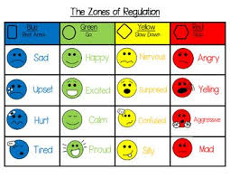
Zones of Regulation!
When :Thursday, November 19th at 7pm!
Google meet:
https://meet.google.com/gom-izny-cwh
Song introducing the Zones of Regulation
Please join me for an informational night on the zones of regulation. We will discuss the different zones and coping strategies!!

