Slide 4
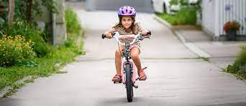
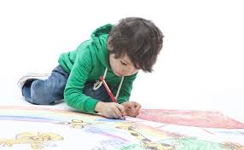
Five jumps
Clap your hands ten times
Tap your head ten times
Run in place for for ten seconds

Slide 6
Show and Share:
Find something that makes you happy.

Slide 7
https://www.foldnfly.com/#/1-1-1-1-1-1-1-1-2
Write a positive message on your paper airplane.

