Slide 1
College and Career Center Seniors Class of 2022
Hi there! It’s me, your school counselor intern, Ms. Denish! =) If you need more support after browsing these resources, or need to make an appt. with me, please reach out via email. More resources can be found on our counseling website here.
Career Exploration
Financial Aid
4-Year University
Community College
CTE & Trade School
Military
Employment Support
Welcome to Counseling!
You can click on almost anything embedded in the following pages and it will take you to a linked resource video or website.
START HERE!
Take our Senior Survey

Slide 2
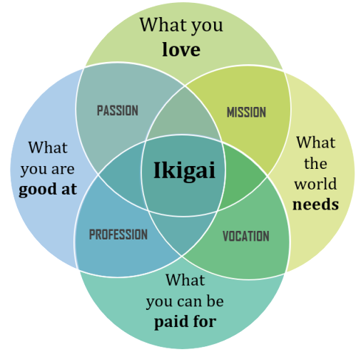
Feeling like this?
Career Surveys
Budgeting
How much $$ will I need to live the life I want?
Discover your Ikigai or purpose
Choosing a Major/Career Focus
Career Exploration Resources
Start Here!

Slide 3
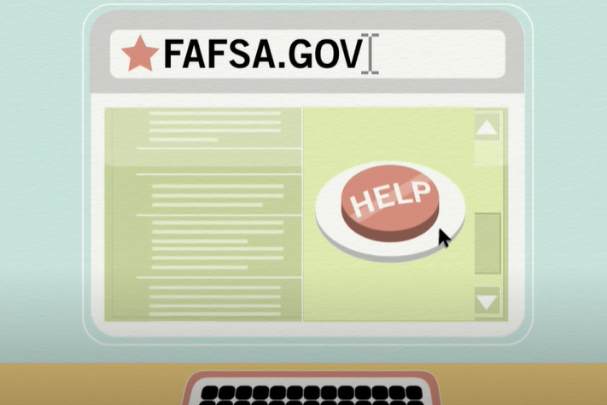
What is
Financial Aid?
How to Apply to FAFSA
Why apply?
NJ Alternative Application
Financial Aid Resources
IMPORTANT!All the info you will need!
LOCAL SCHOLARSHIP APPLICATIONS HERE!!
FAFSA & CADAA Worksheet

Slide 4
4 Year University Resources
NCAA Updates

Slide 5
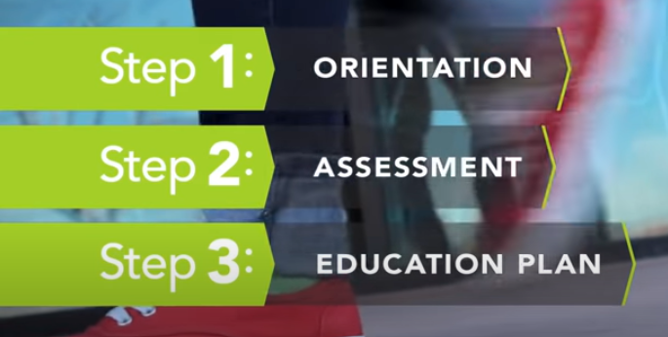
Why Community College?
How do I get there?
Community College Resources
Interested in Trade (CTE) or Certificate Programs? Check out the next slide!

Slide 6
Why Career Tech Ed (CTE)?
CTE & Trade School Resources

Slide 7
Which Branch?
Interested in Enlisting?
ASVAB Info
MEPs Info
Military Resources

Slide 8
Do you have a job?
Earn work experience credits!!
Employment Support Resources

