Slide 3
How do I stay in this GREEN zone?

Slide 5
What can I do??

Slide 7
What can I do to get back to the green zone?

Slide 8
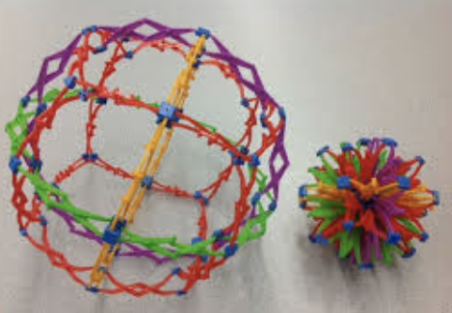
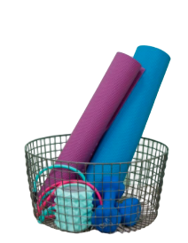
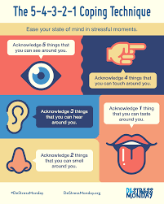
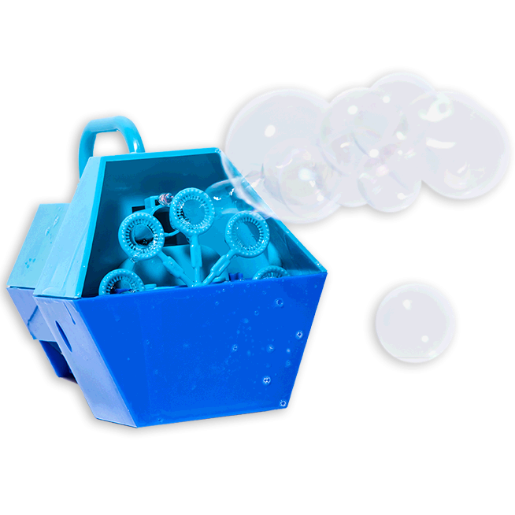
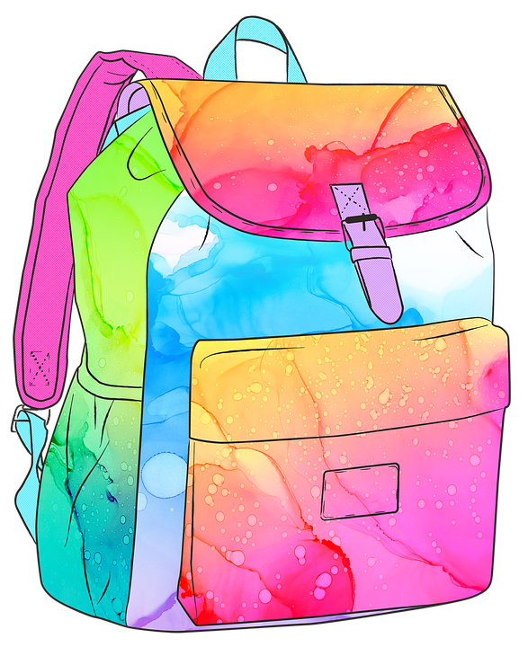

Slide 9
I need help, what can I do?

Slide 10
