Slide 1
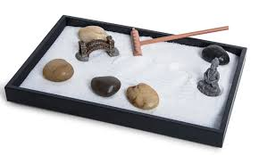
Ms.Denish
Y
U
MATTER
Resources
Please click here if you would like to make an appointment with the counselor
HIB policyy
S12 policy
Ms. Santiago”s
Website
StopIt Code
TPESTigers
2020
Click on items around my office for links
Return to
Learn
Plan
COVID Resources
Mental Health Resources
Educational Planning Guide
ext.6006

Slide 2
Zen Den
Coloring Pages
Zen Garden
RELAXATION ROOM
Guidance and Counseling & Mental Health / Mindful Scripted Meditation
Breathe

Slide 3
Mental Health Resources
If you are experiencing a mental health emergency, please dial 988 or contact:
Crisis Hotline at 1-800-273-8255
Or visit the National Suicide Prevention Lifeline
National Suicide Prevention Lifeline
Or call 911 or go to the nearest emergency room/hospital
S12 Policy
WHATEVER IS WORRYING YOU RIGHT NOW, FORGET ABOUT IT.
TAKE A DEEP BREATH, STAY POSITIVE AND KNOW THAT THINGS WILL GET BETTER.
This Photo by Unknown Author is licensed under CC BY
This Photo by Unknown Author is licensed under CC BY-ND

Slide 4
Welcome Parents
Social Emotional Learning:
It’s ok to make mistakes, and believe in yourself

Slide 5
COVID Resources
Wear your mask regularly & properly.
Maintain 6 feet social distance.
Wash your hands correctly and often

Slide 6
Character Education
Please view this video of the students celebrating International Dot Day

