Slide 1
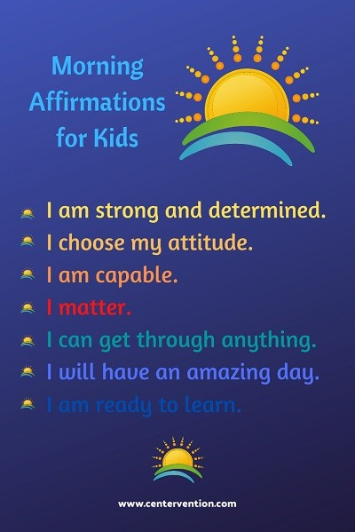
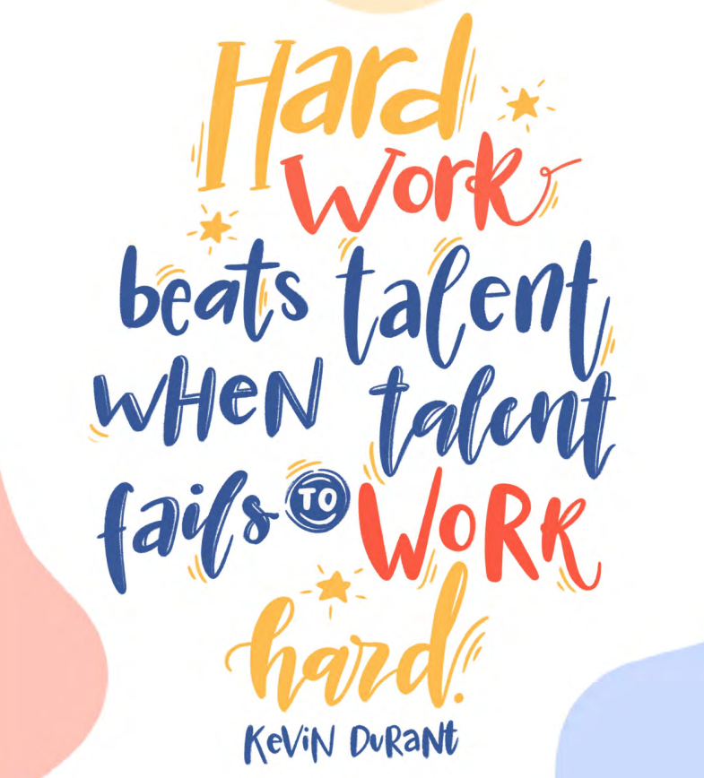
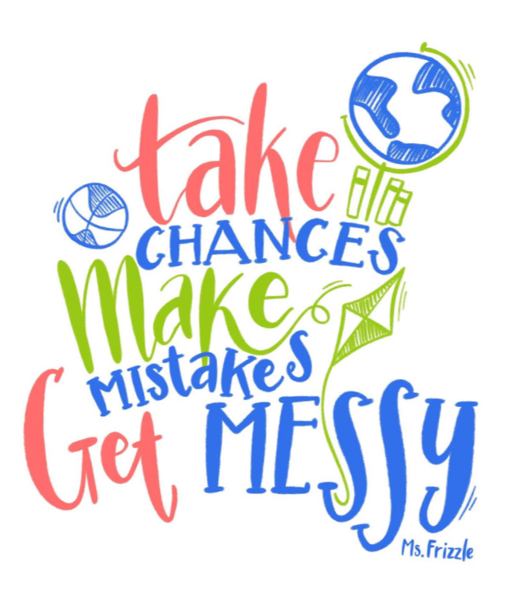
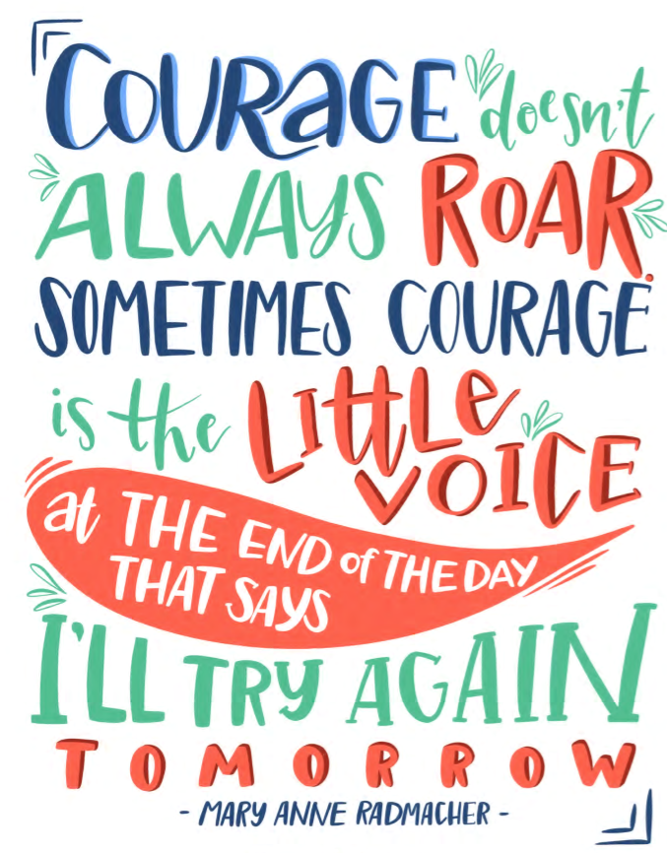
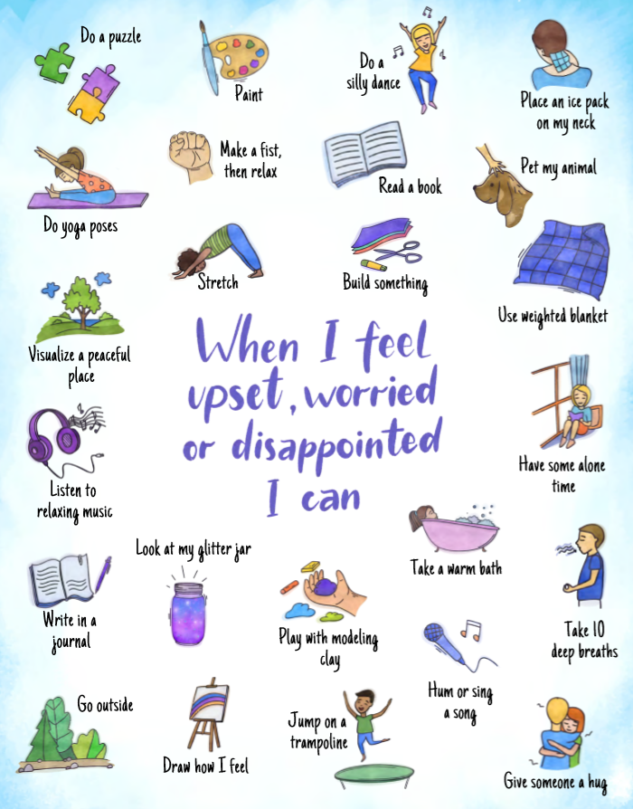
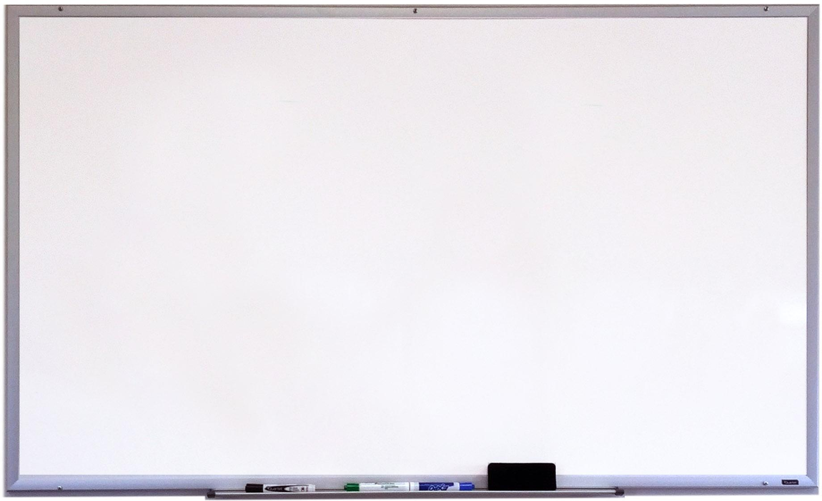
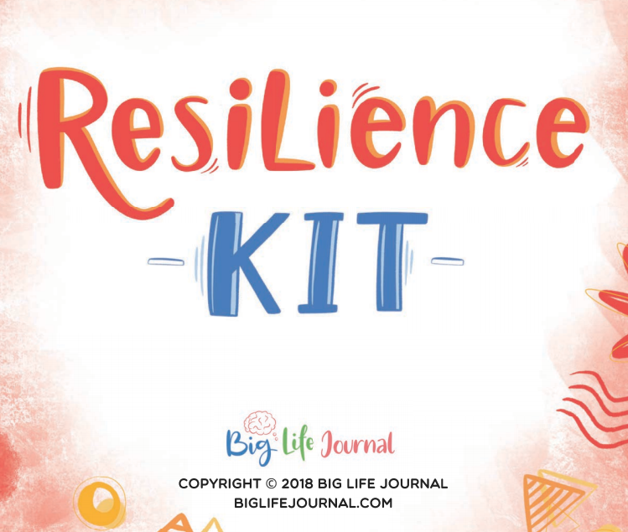
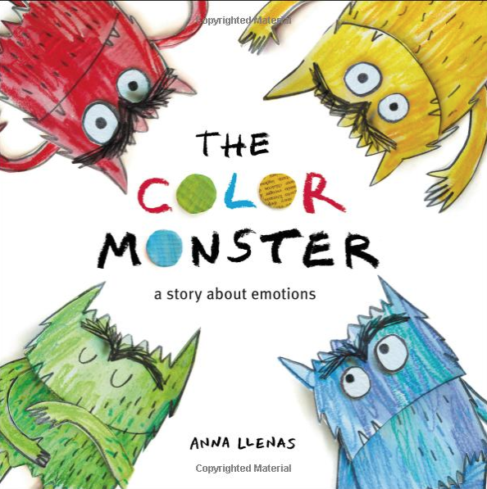
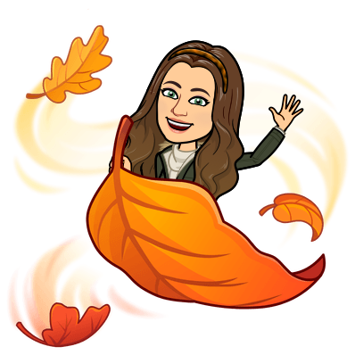
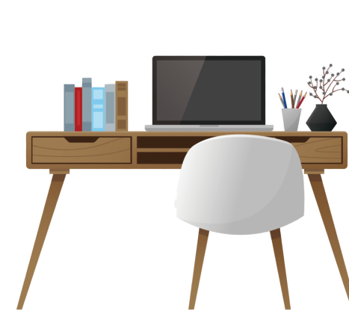
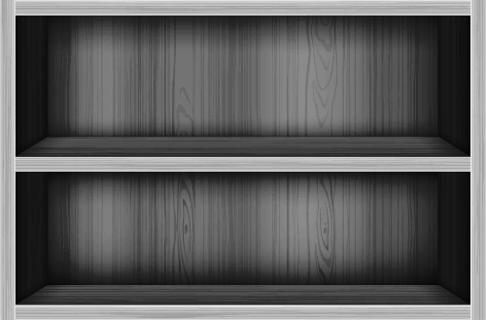
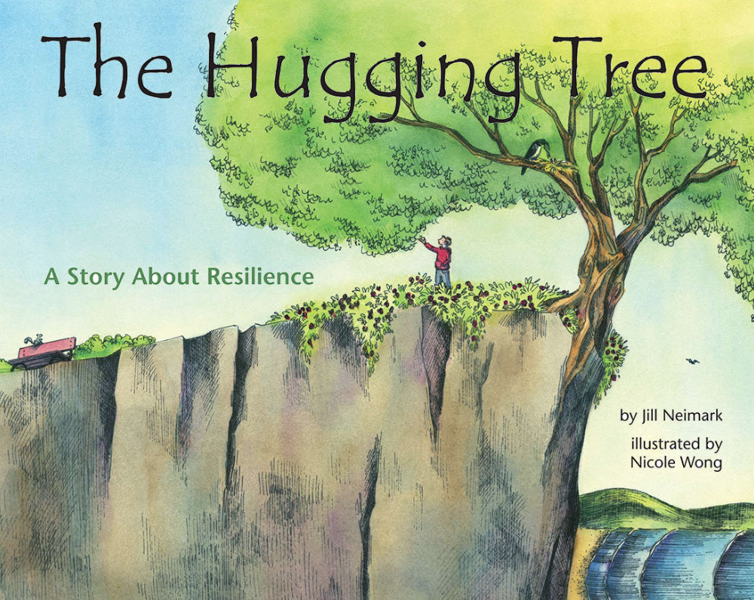
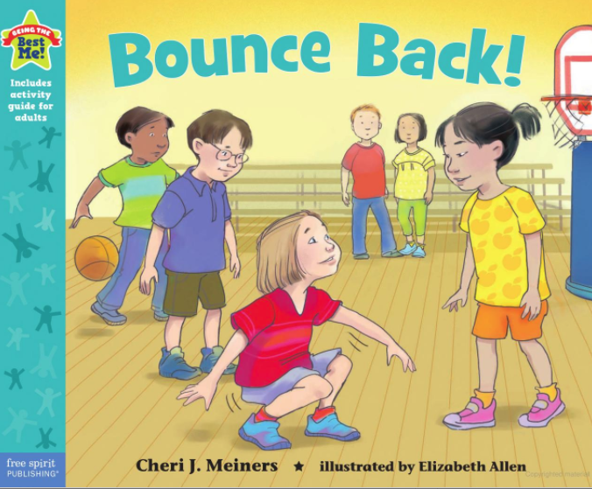
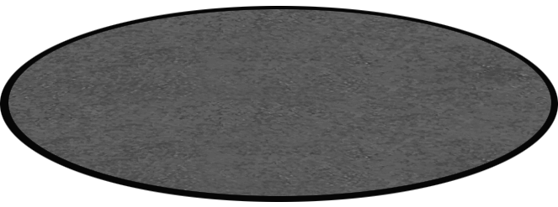
Notes:
Created by Carrie Galindo
The Posters and Assignment materials are copyrighted by My Big Life Journal

Slide 2
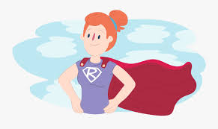
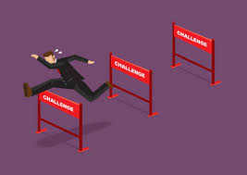
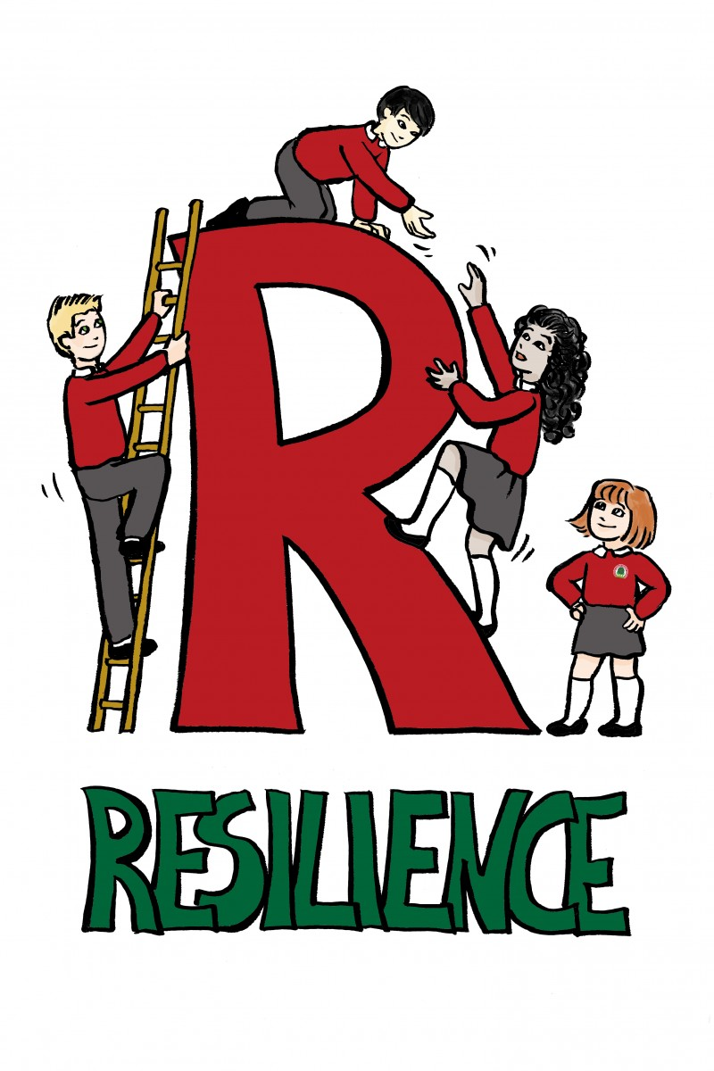
Resilience
Resilience is the ability to bounce back from stress, failure, challenges, or even trauma. It's not something that you either have or don't have; it's a skill that you develop as you grow. How do these pictures relate to resilience?

Slide 3
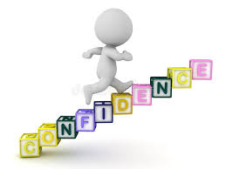
The 7 C’s of Resilience
1. Competence
Know that you have the ability for a skill, activity, sport or passion.
2. Confidence
The belief in your own abilities. Recognizing your ability to succeed will help you tackle challenges.
3. Connection
Having good relationships to family, friends, teachers, and the surrounding community.

Slide 4
4. Character
Knowing who you are, knowing your values, knowing what’s right versus what’s wrong, and the gifts you have to offer
5. Contribution
Recognize what you have to offer to the world. Your helping of others will make it easier for you to ask for help, which is a major part of being resilient.
6. Coping
There are a bunch of ways to cope with any situation. Strategies like writing, expressing feelings, playing with games/friends/animals, and more are great ways of avoiding stressful situations and lettings things go.
7. Control
When you realize you’re in control of your decisions and actions, you are more likely to have what it takes to bounce back.

Slide 5
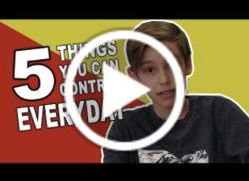
What is in my control?

Slide 6
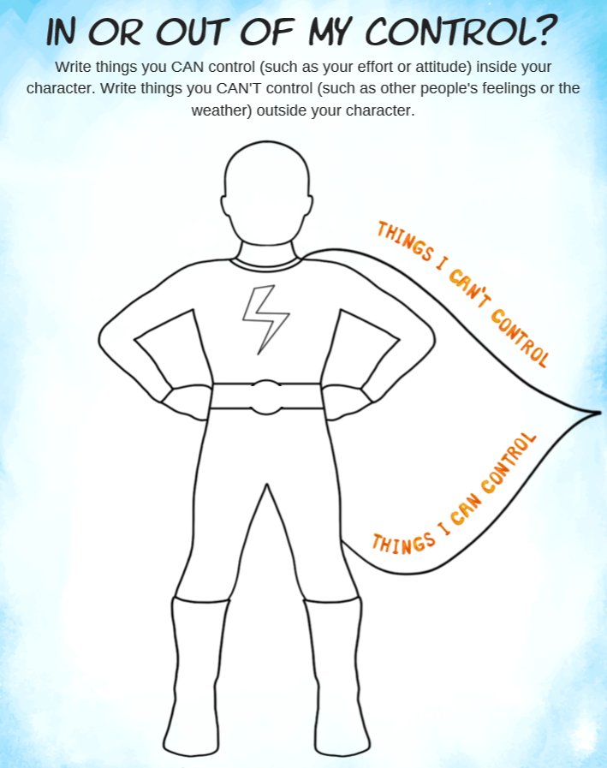
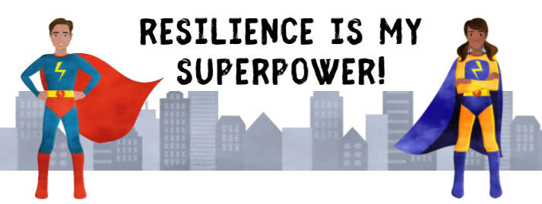
This link will take you to your Google Classroom. It will automatically open in a new tab. Please complete the activity and turn it in. Then come back here to continue exploring!
Notes:
Created by Carrie Galindo
The Posters and Assignment materials are copyrighted by My Big Life Journal

Slide 7
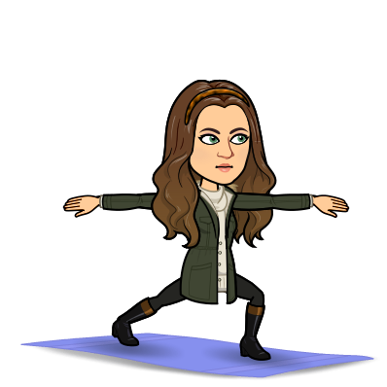
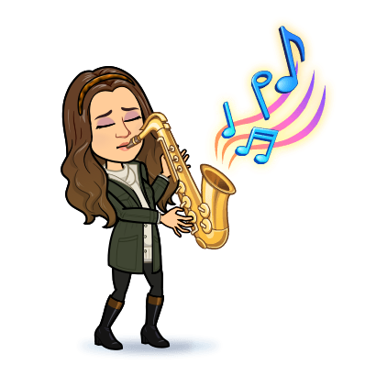
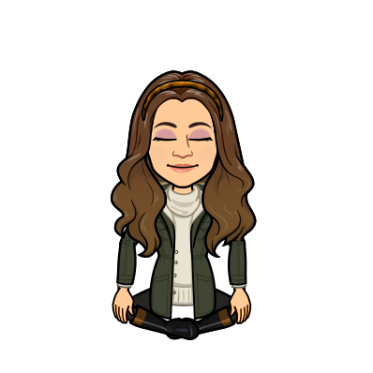
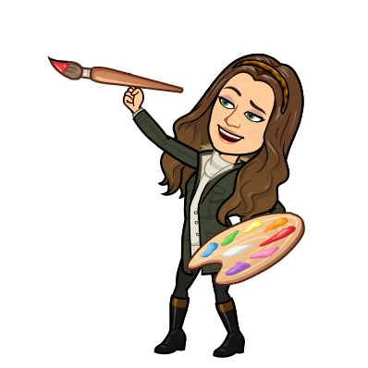
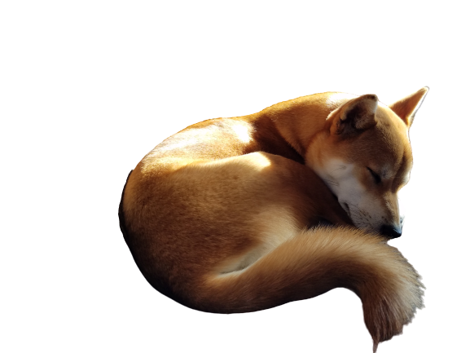
Sometimes when things happen that are Out of Your Control, you might feel upset, worried, or disappointed. When that happens, there are things you can do to help yourself feel better!
Click on each of my characters below for a fun activity!
Notes:
Created by Carrie Galindo
The Posters and Assignment materials are copyrighted by My Big Life Journal

Slide 8
