Slide 1
What is the theme of the book? Inclusion and welcoming others.

Slide 2
Brown eyes:
Hop on one foot
Long hair:
Touch your head, shoulders, knees, and toes
Wear glasses:
Touch your eyes, ears, nose and mouth
Blue eyes:
Touch your toes five times:
Green eyes: Reach for the stars
Short hair: give yourself a big hug
Notes:
K-1st

Slide 3
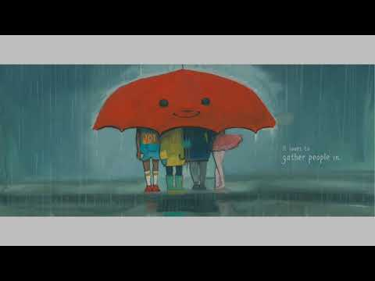

Slide 5
1
2
3
4
5
Notes:
2nd-5th under each color or number is a scenario

Slide 6
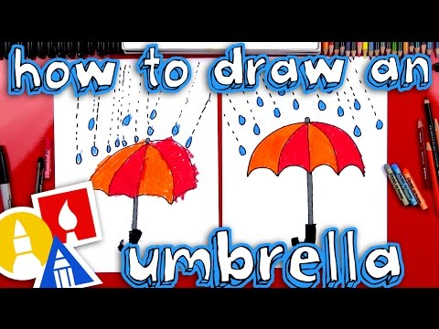
Draw an umbrella and a raindrop . In the raindrop write down the message of the story.

