Slide 1
The Zones of Regulation
Along with each zone, there are behaviours that might accompany these emotions. The goal of the zones is to have students identify what zone they are in, and what they need to do in order to move towards the green zone when they are at school, which is the optimal zone for le
GREEN ZONE | BLUE ZONE | YELLOW ZONE | RED ZONE
Happy Focused Ready to learn content | Sad Tired Sick Slow | Anxious Annoyed Losing control Stressed | Acting out Angry Mean or hurtful

Slide 2
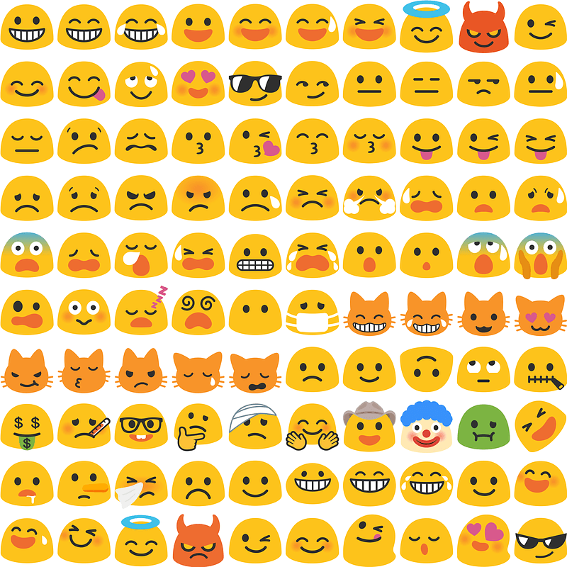
WELCOME TO ZONES!
It is normal to experience many different emotions every day! Some are good, some don’t feel so good. When we are at school, it is important for us to be able to learn and be happy.
Understanding the Zones can help you:
Understand your emotions
Know how to respond properly to our emotions
Develop your personal zones toolbox
In the next slides, we will review each Zone so you can better understand how to respond to your emotions!

Slide 3
GREEN ZONE
In the green zone, we can learn our best! You might feel:
Happy
Content
Optimistic
Ready to learn
This is the zone we want to be in while we’re at school!

Slide 4
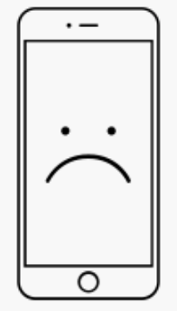
BLUE ZONE
In the Blue Zone, you might feel:
Tired
Sick
Sleepy
Sad
If you’re in the Blue Zone, you can:
Go for a walk
Eat a snack
Rest for a little bit

Slide 5
YELLOW ZONE
In the Yellow Zone, you might feel:
Anxious or stressed
Frustrated
Silly
Excited
If you’re in the Yellow Zone, you can:
Ask for a break
Go for a walk
Play with a fidget toy
Take some deep breaths or count to 10

Slide 6
RED ZONE
In the Red Zone, you might feel:
Angry
Furious
Destructive
Yelling
If you’re in the Red Zone, you can:
Seperate yourself from others
Go for a walk
Go to a calm down space
Go to your calming box for 2 minutes

Slide 7
Reflect!
Now that you understand each zone, try to think back to a time where you were in each zone. How did you feel? What did you do to help yourself feel better?
Check back to the previous slides if you need help remembering which emotions belong to which zone.
Fill out the reflection chart on the next slide.

Slide 8
Your Zones Toolbox
Everyone has their own toolbox of strategies that help them move to the green zone. Using the information you included in your Reflection Chart, record some of your favourite strategies that help you move towards the green zone in the space below. What are some tools in your calming box
(Type your responses here)

Slide 9
Reflection Chart
Zone 10:40 | How did it feel? | What did you do to move back to green?
Green
Blue
Yellow
Red

Slide 10
Reflection Chart
Zone | How did it feel? | What did you do? | What could you have done differently?
Green
Blue
Yellow
Red

Slide 11
Reflection Chart
Zone | How did it feel? | What did you do? | What could you have done differently?
Green
Blue
Yellow
Red

Slide 12
Reflection Chart
Zone | How did it feel? | What did you do? | What could you have done differently?
Green
Blue
Yellow
Red

Slide 13
Reflection Chart
Zone | How did it feel? | What did you do? | What could you have done differently?
Green
Blue
Yellow
Red

