Slide 1
World Kindness Week
#WKW

Slide 2
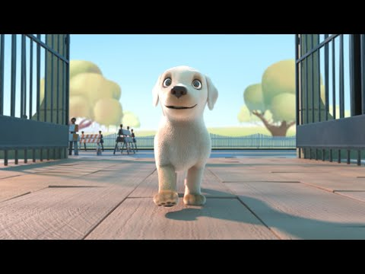
Watch and Reflect

Slide 3
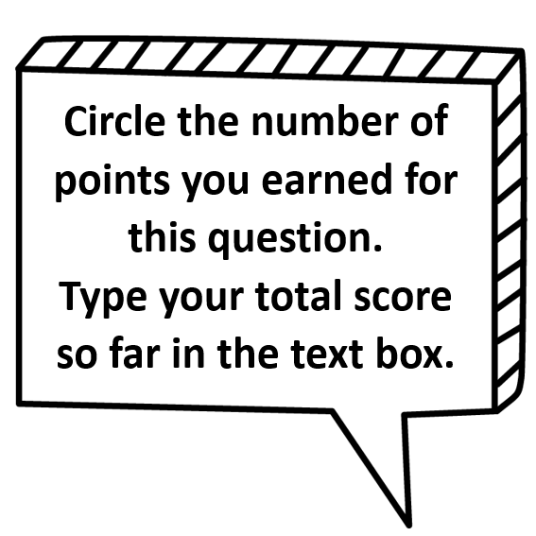
Text

Slide 4
Text

Slide 5
Text

Slide 6
Text

Slide 7
Text

Slide 8
Text

Slide 9
Text

Slide 10
Text

Slide 11
Text

Slide 12
Text

Slide 15
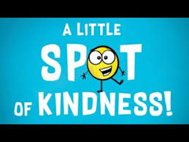
Mark a spot of kindness each day! Type it/insert pictures of what you did to show kindness.
Tuesday:
Wednesday:
Monday:
Thursday:
Friday:

Slide 17
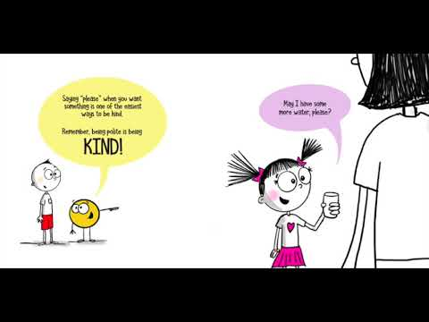

Slide 18
Monday, November 9 ,2020
Kindness Challenge for Today: Art and Animals
Are you ready for a week of kindness? Today we kick off #WorldKindnessWeek with activities to find meaning in art through acts of kindness. You can go as big or as small as you want, but if you need some guidance, we’ve got you covered. See our three daily suggestions for how you can get involved.
Choice #1: Read Each Kindness by Jacqueline Woodsen. In the book, Ms. Albert, the teacher, describes each kind act as the rippling through the world. Create a work of art showing how kindness ripples through the world. When finished, be sure to sign your name. Send a picture to your teacher of your art!
Choice #2: Dance to “Kindness is a Muscle” Show us your Kindness Muscle. Grab a friend or loved one, put on your favorite song and dance like no one’s watching! Send a picture to your teacher of your kindness dance party!
Choice #3: Show your love for your animals through action! (Groom your pet, feed your pet, walk your pet, love your pet!) Send a picture of how much you love your pet to Ms. Santiago’s classroom!
Optional to do with your family: Paint a Kindness rock: Paint a rock and write a positive phrase like, “You are Awesome!” showing kindness to others and place it for someone to find. Remember your affirmation. Send a picture to your teacher of your kindness rock!

Slide 20
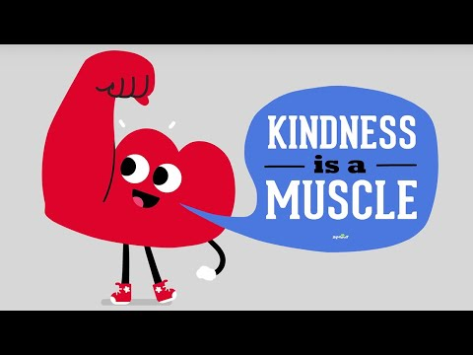

Slide 21
Tuesday, November 10 ,2020
Kindness Challenge for Today: YOU!
Today’s focus is YOU. We’ve got three suggestions for how you can show yourself a whole lotta love.
Pick 1: High five-a-day!
Have you had your recommended five-a-day fruit and veg yet? Healthy eating means a healthy body and mind. Today, ditch the fast food and feast on nature’s ready meals! What better way to show yourself kindness and respect than by eating well? Write a menu with all your favorite fruits and vegetables.
Pick 2: Look after you!
During #WorldKindnessWeek, we ask you to spread kindness to others, to animals and our planet. But today, be kind to yourself. You can only look after others if you are looking after yourself. Practice positive self-talk, take it easy, treat yourself to lunch and feel gratitude for the wonderful person you are! Watch The Reflection in Me, to remind yourself how special that person is who is look at you in the mirror.

Slide 23
Wednesday, November 11,2020
Kindness Challenge for Today:
We hope you’re loving the acts of kindness, keep sharing them with us! Today is about being a good and kind citizen in your community. Do your own thing, or check out our suggestions.
Pick 1: As a Member of the Paine Communtity!
Using the words of the Paine School Pledge, illustrate and draw what it means to you. You can create a mural drawing, an decorated banner of the words or a picture of your being a citizen of the Paine Community. Snap a picture and send it to Ms.Santiago.
Pick 2: As a Global Citizen
How did you show kindness to your community today?
The kindness continues tomorrow. Check back for our next two themes, culminating with World Kindness Day on Friday.
#WorldKindnessWeek #2020 #Civickindness

Slide 24
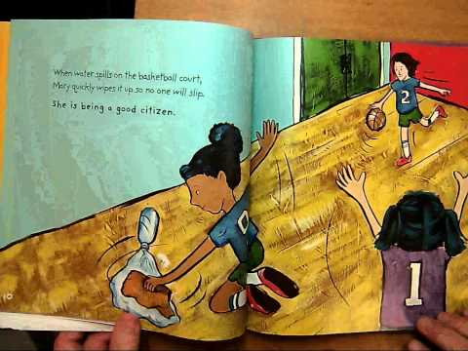

Slide 25
Thursday, November 12,2020
Kindness Challenge for Today:
Our focus today is on ways to protect Mother Earth, and here are our three picks for the day.
Pick 1: Save water and turn off the tap Do you keep the tap running when you brush your teeth? Think about it: brushing your teeth twice a day for at least two minutes, with the tap running, adds up to a lot of water. Save water and turn off the tap.
Pick 2: Change starts with you!
Watch the video by BrainPop Jr. “Reduce, Reuse, Recycle”. Draw a poster that can teach others the importance of using the 3Rs to help our planet. Send a picture to your teacher.
Pick 3:
What steps did you take today to save our planet? Share with #WorldKindnessWeek #2020 #Ecowarrior

Slide 26
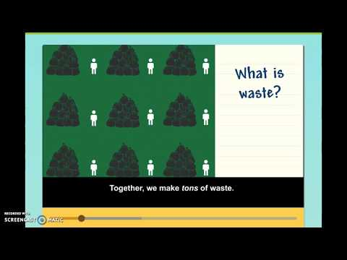

Slide 27
It's World Kindness Day
#WorldKindnessDay

Slide 28
Friday, November 13,2020
Kindness Challenge for Today:
Happy World Kindness Day! We hope you’ve enjoyed your week of mindful and kind activities, and seen the impact of your actions. Today we celebrate being part of the human race and showing kindness and love to one another. We’ve saved the best for last; here are three ideas to inspire you.
Pick 1: Pick up the phone!
Today, have a parent help you call someone you love. When someone says: “It’s so nice to hear your voice!” it’s because they knew you took time out of your day to check in with them. Verbal connection is much so powerful and so kind! That kind is a ripple you send out into the world!
Pick 2: Thinking of You
Send a card or a picture to someone you care about.. They’ll be surprised and glad to have a thoughtful friend like you!

