Slide 1
PRIMARY
Tiger Rally

Slide 3
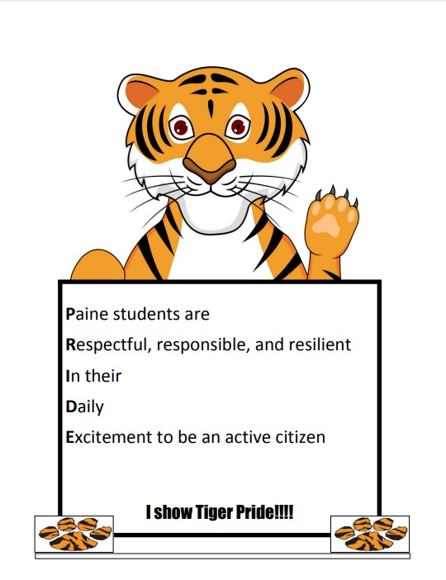
Thomas Paine Pledge

Slide 4
Now we are going to announce the students who showed respect for the month of October

Slide 5
Kindergarten

Slide 6
First Grade

Slide 7
Second Grade

Slide 8
Third Grade

Slide 9
Fourth Grade

Slide 10
Fifth Grade

Slide 11
How do we respect ourselves, others and our environment?
Flipgrid presentations

Slide 12
Red Ribbon Week

Slide 13
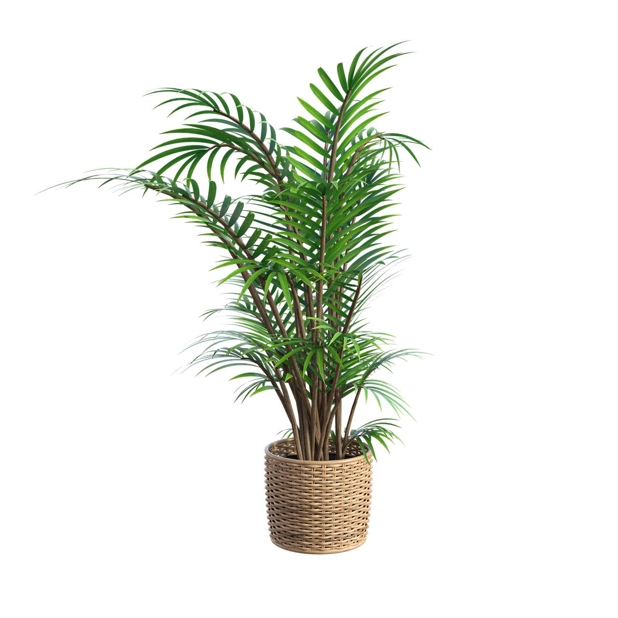
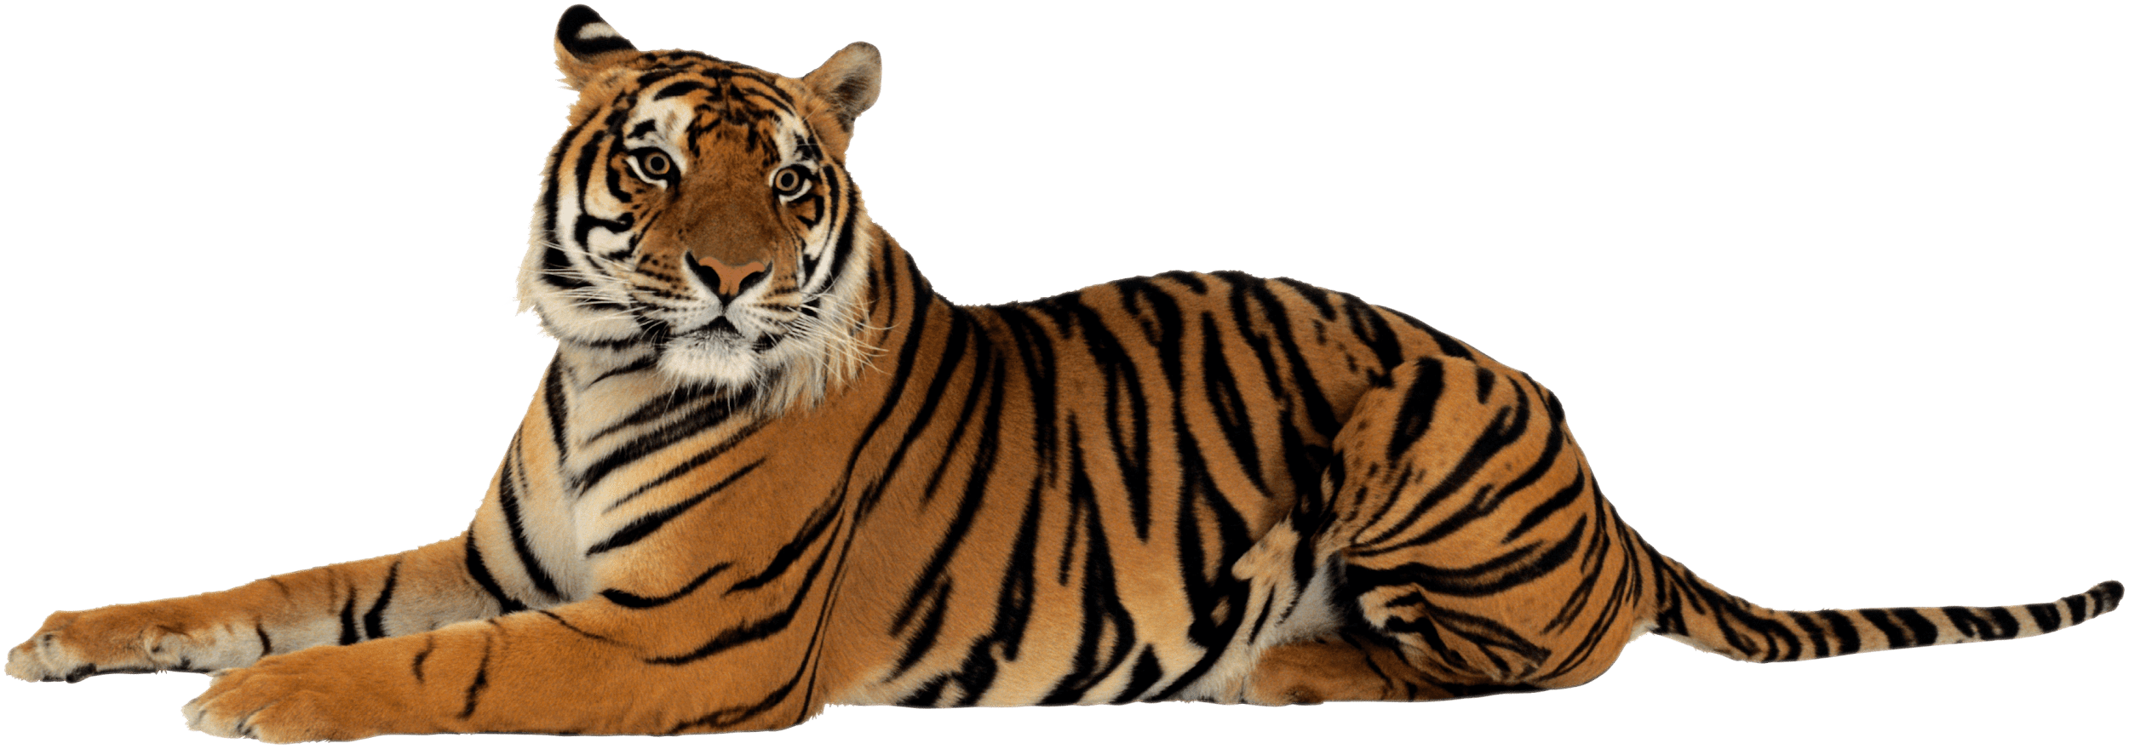
Take The Pledge!
Notes to Mrs. Collins
Monday
10/26
Wear Red
Day
Tuesday
10/27
Wear a
hat
Thursday
10/29
Wear your shirt backwards
Friday
10/27
Wear pajamas
Wednesday
10/28
Wear Sweats or work out clothes
Theme Contest!
Enter
Here

Slide 14
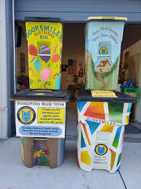
CALLING ALL TIGERS
Thomas Paine is a partner with BookSmiles.org
Create a design to make our book collection container stand out.
Designs must include:
something that represents Thomas Paine
a slogan or picture to encourage the community to donate books
will cover one side of the recycle bin
Together we can reduce our waste and help others.
Submit all designs to: lcollins@chclc.org
All entries must be turned in by 10/30/2020
Winner will receive a T-Paine prize

Slide 15
TPE Virtual Halloween Parade
Upload your pictures to Ms. Santiago’s Classroom under Halloween Costume Assignment.

