Slide 1
Why Try?
Today’s topic: The Motivation Formula

Slide 2
Key Concept:
You can take your challenges and channel them into positive motivation; first, to better yourself and then, to turn outward and help others.

Slide 3
Let’s think about it...
What is the bravest thing you have ever done?
Why did you do it?

Slide 4
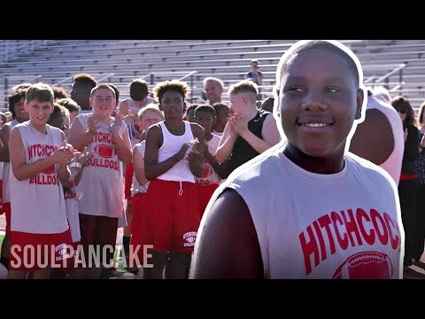
Video Clip!

Slide 5
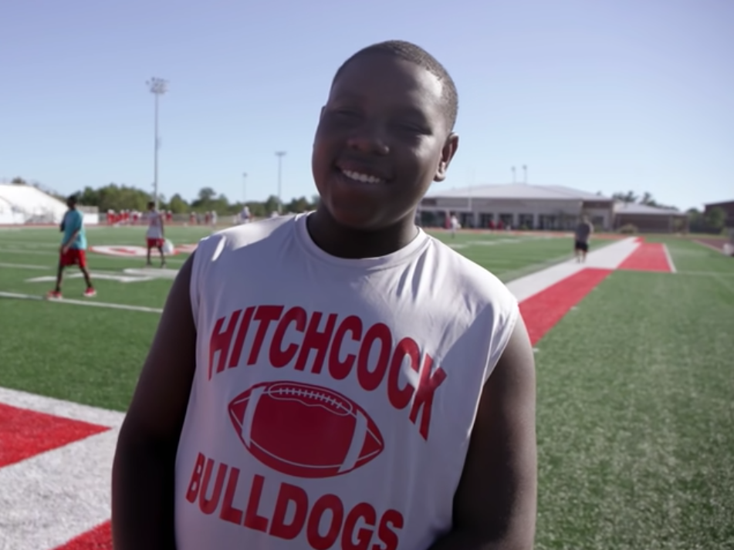
Processing the clip:
What challenge did Virgil and others face in this video?

Slide 6
Processing the clip:
What challenge did Virgil and others face in this video?
How did Virgil overcome the challenge?

Slide 7
Processing the clip:
What challenge did Virgil and others face in this video?
How did Virgil overcome the challenge?
Why didn’t he give up?

Slide 8
Processing the clip:
What challenge did Virgil and others face in this video?
How did Virgil overcome the challenge?
Why didn’t he give up?
How did he help others with the challenges they were facing?

Slide 9
Processing the clip:
What challenge did Virgil and others face in this video?
How did Virgil overcome the challenge?
Why didn’t he give up?
How did he help others with the challenges they were facing?
What can we learn about this for our own lives?

Slide 21
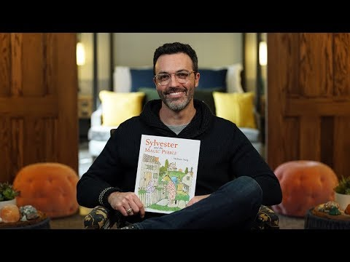

Slide 22
Sylveter and the Magic Pebble
On a rainy day, Sylvester finds a magic pebble that can make wishes come true. But when a lion frightens him on his way home, Sylvester makes a wish (choice) that brings unexpected results.
What Sylvester chose to become a rock, what were the negative results?
Sylvester is turned into a large rock unable to do anything to help himself. Essentially he has lost all opportunity, freedom, and self-respect.
Sylvester is eventually saved by his parents (his support system). How Sylvester is eventually reunited with his loving family and restored to his true self makes for a story that is beautifully tender and filled with magic.

Slide 23
Story: Butterfly Story
http://www.hawaiiswim.org/business/TheButterfly/TheButterfly.html

Slide 24
Create your own creed or motto
Art Assignment
You can use any art medium to do this (colored pencils, photos, pictures from internet or magazines, etc). It should represent something positive you want to become or achieve. It can be something to tell yourself (positive self-talk) when things are getting intense. Remember you can't control everything that happens; only what you do about it.
Put your creed or motto somewhere you will see it every day (locker room, mirror, etc)

Slide 25
Journal Activity
Write about a time when you used positive self-talk to get through a challenge.
How did it help?

Slide 26
Plugging in Activity
Ask a parent, guardian or someone you know what is the biggest challenge they have overcome in their life. Ask them how they overcame that challenge.
Try and identify their strategies and compare them to the four strategies we learn through the Motivation Formula of (positive self-talk, character and heart, passions & interests, support systems).

