Slide 1
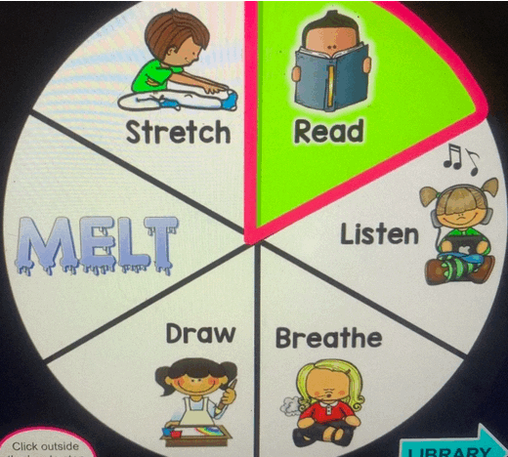
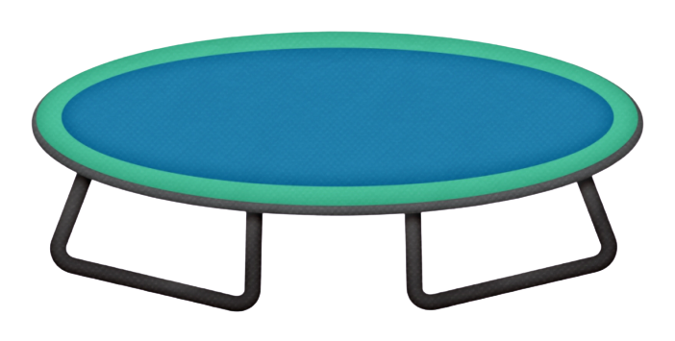
Welcome to the Calming Zone!
Click on the to access the items!
Home
Home

